Slide 1
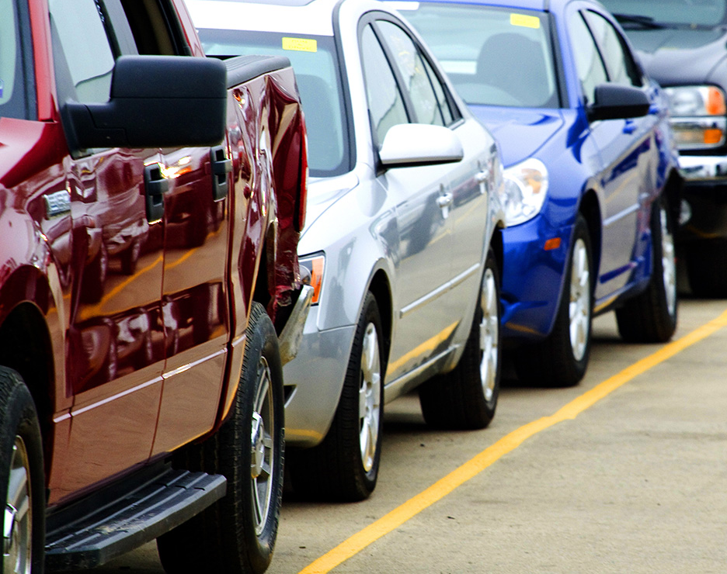

Vehicle Classification Using Computer Vision for KAR Global
UChicago MScA Capstone Project
Yue Wu, Chuyu Chen, Hsuan-Hao Lin, Jack Gao
March 3, 2022

Slide 2
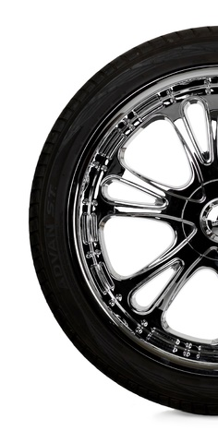
Agenda
1
Project Overview
2
Data & Feature Engineering
3
Methodology & Findings
4
Conclusion & Demo

Slide 3

Project Overview
Value Proposition
Client Background
Problem/Opportunity Statement
Goals & Challenges

Slide 4
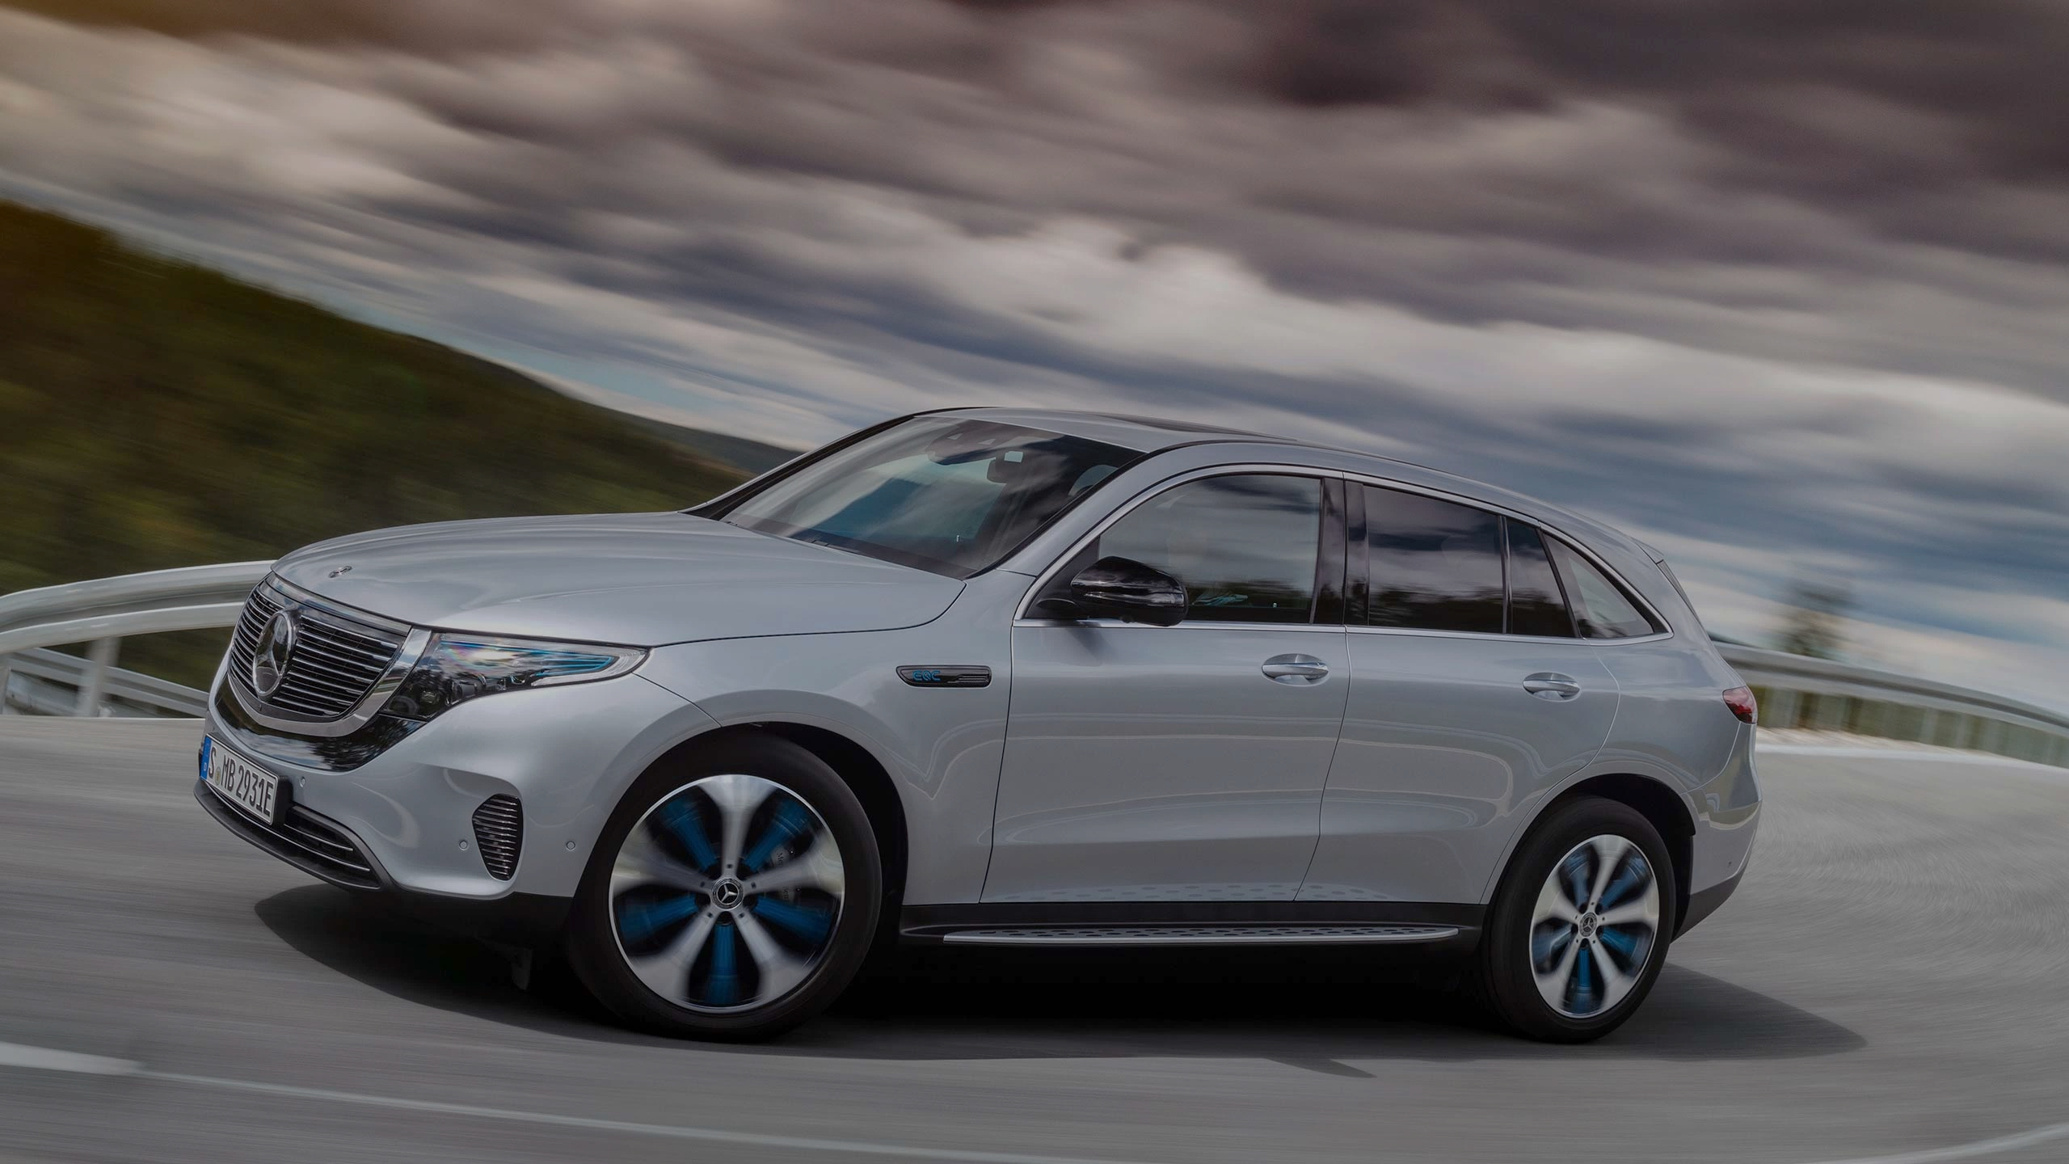
Targeted Pitch Line
Value Proposition
Saved budget and accelerated vehicle inspection process by classifying car images automatically using computer vision models
Notes:
Accelerate and automate vehicle inspection process by classifying car images automatically using computer vision, instead of manual labelling

Slide 5






Client Background
Overview of KAR Global
KAR Global is a leading provider of used vehicle auctions and a company that provides remarketing solutions to sellers and buyers
KAR Global is a company that integrates technology, analytics, and auction to leverage data and accelerate remarketing
Used Vehicle Trade in
Specialist On-site Inspection
Physical Auction
Current
Auction
Technology
Future
Auto Inspection through Images
Virtual Auction
Analytics
Source: KAR Global annual report
1. Project Overview
4. Conclusion & Demo
2. Data & Feature Engineering
3. Methodology & Findings
Notes:
Overview of KAR Global

Slide 6
Problem/Opportunity Statement
Business Problems
Opportunities
Mislabeling and inefficiency from manual classification process
Increasing difficulty of conducting car inspection at physical auction site due to COVID
Increasing demand of real-time vehicle report data to help identify the cars that the customers want
Use computer vision models to classify car images
Automate entire car inspection process and potentially move it upstream
Accelerate the classification process and save budget
1. Project Overview
4. Conclusion & Demo
2. Data & Feature Engineering
3. Methodology & Findings

Slide 7
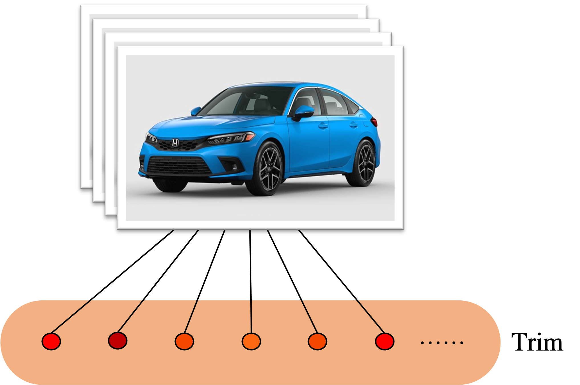
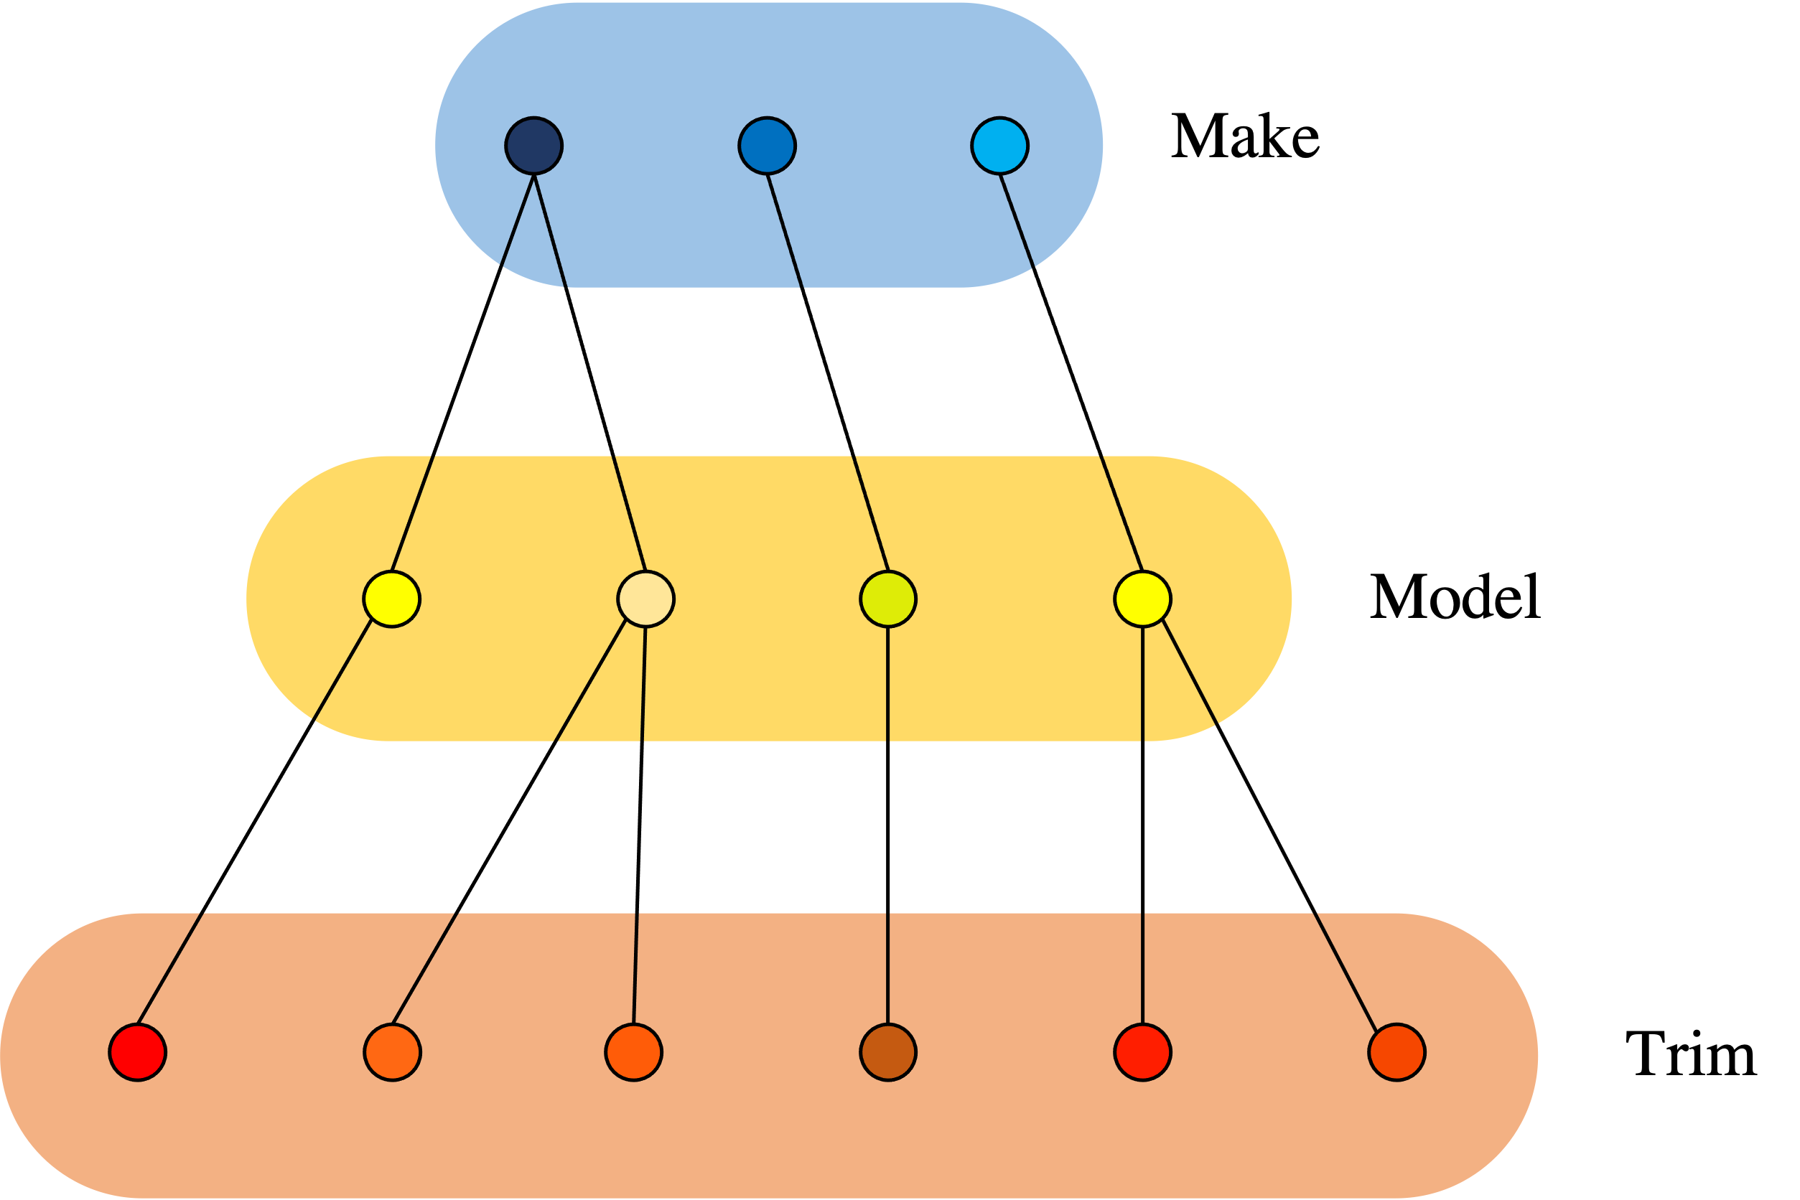
Goals & Challenges
Phase 3: Integrate Model Into Production Pipeline
Phase 1: Research, Exploratory Analysis & Data Cleaning
Phase 2: Explore Flat and Hierarchical Structure
Challenge: Massive data cleaning for trim level; poor image quality
Goal: Facilitate seamless model integration
Challenge: Computing power constraint; multiclass classification with large number of categories; subtle image differences at trim level
Goal: Use hierarchical CNN to classify make, model and trim of a vehicle
Goal: Figure out potential modeling architectures, and get dataset ready for training
Flat Structure
Hierarchical Structure
1. Project Overview
4. Conclusion & Demo
2. Data & Feature Engineering
3. Methodology & Findings

Slide 8
Data & Feature Engineering

Slide 9
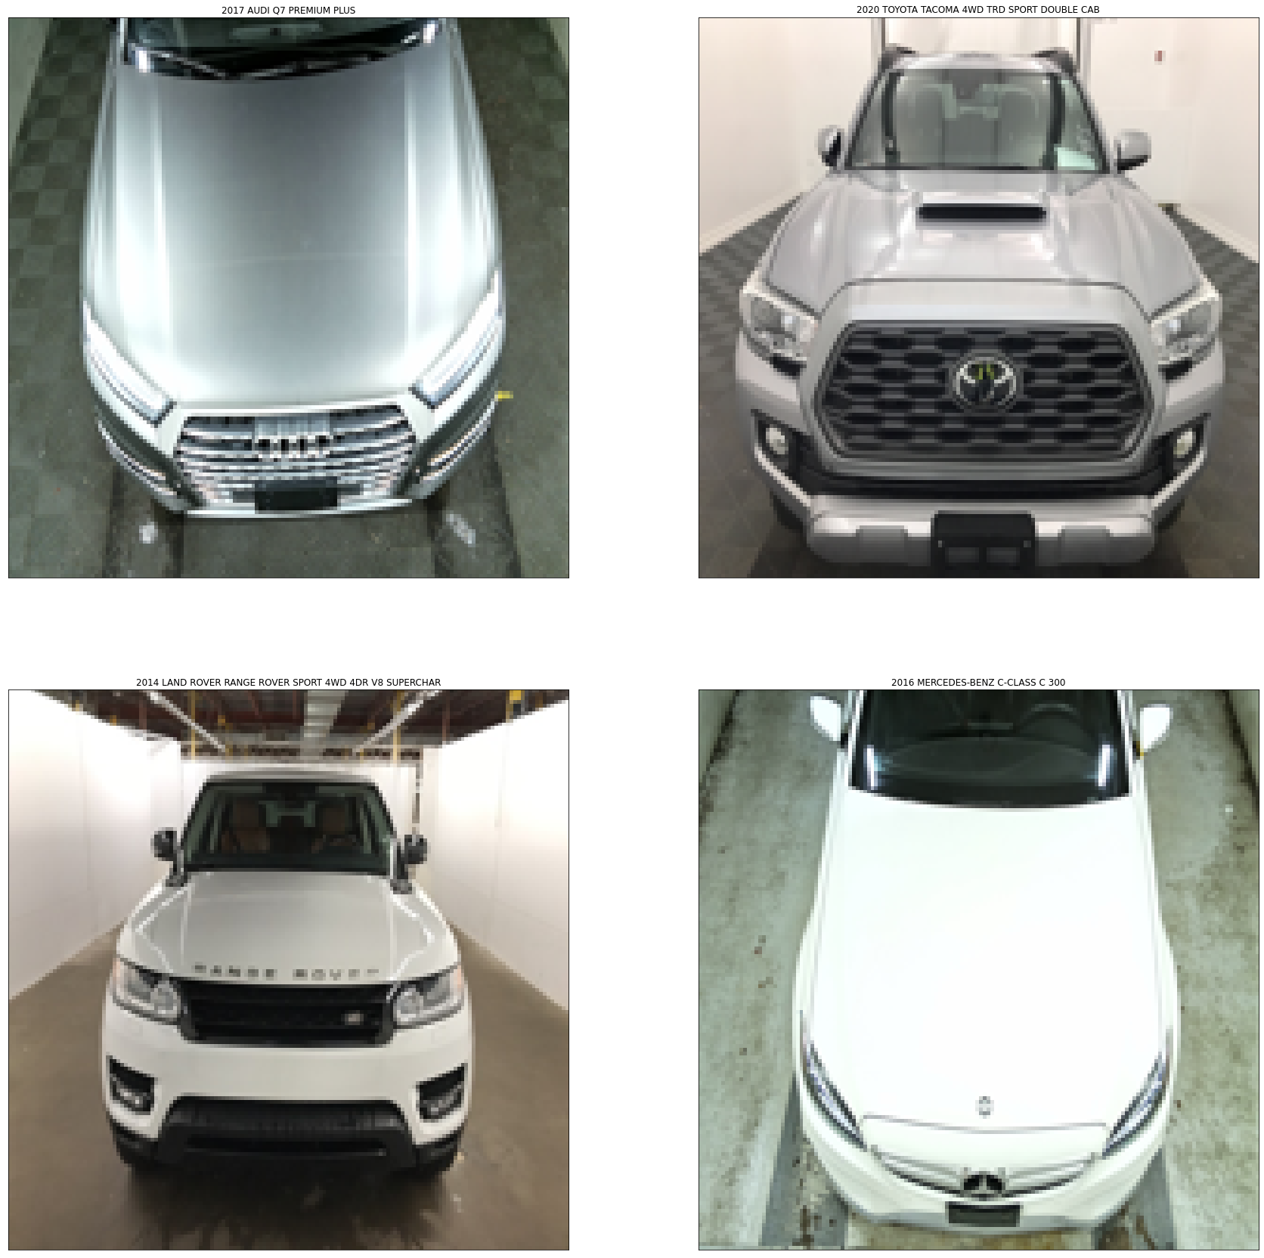
Vehicle Image Dataset
68
Vehicle
YEAR
6,034
Vehicle MODEL
10 M+
Vehicle Images
936
Vehicle
MAKE
Image Angles
22,830
Vehicle
TRIM
Front
Rear
Left front
Left rear
Right front
Right rear
1. Project Overview
4. Conclusion & Demo
2. Data & Feature Engineering
3. Methodology & Findings

Slide 10
Data Cleaning
1
Initial Cleaning
2
Label & URL Cleaning
Drop NULL
Unify image angle notation
Limit the YEAR range to 2011-2021
Text Normalization
Punctuation / Whitespace Removal
Label Stemming
1. Project Overview
4. Conclusion & Demo
2. Data & Feature Engineering
3. Methodology & Findings
Notes:
Initial Cleaning
Drop null
Unify image angle notation
Limit the YEAR range to 2011-2021
2. Label & URL Cleaning
Text Normalization
Punctuation Removal
Whitespace Removal
Label Stemming

Slide 11


Feature Engineering
1. Prioritization
2. Consolidation
3. Transformation
Shortlist make, model, and trim to top labels
Consolidate model and trim labels that are similar or almost identical
Transform remaining make and model that are outside of top labels to “OTHER”
21 (20 + 1)
MAKEs
Similar Labels
Consolidated
^{90%}
119
MODELs
CIVIC SDN
CIVIC Sedan
CIVIC Sedan
Images from Top 20 MAKEs make up 90% of original dataset
361
TRIMs
1. Project Overview
4. Conclusion & Demo
2. Data & Feature Engineering
3. Methodology & Findings
Notes:
Shortlist make, model, and trim to top labels which represent most of the vehicle in the original dataset
Consolidate model and trim labels that are similar or almost identical
Added ‘OTHER’ class for make and model to identify vehicles that don’t belong to the top brands
65,860 train images, 16,466 validation images, and 20,582 test images

Slide 12
Methodology & Findings

Slide 13
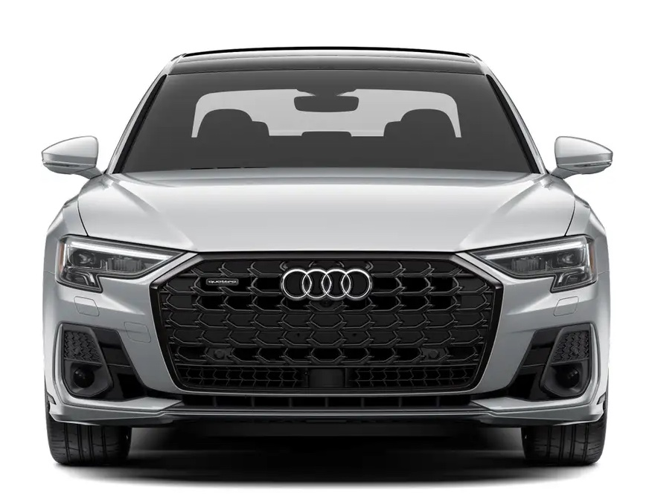
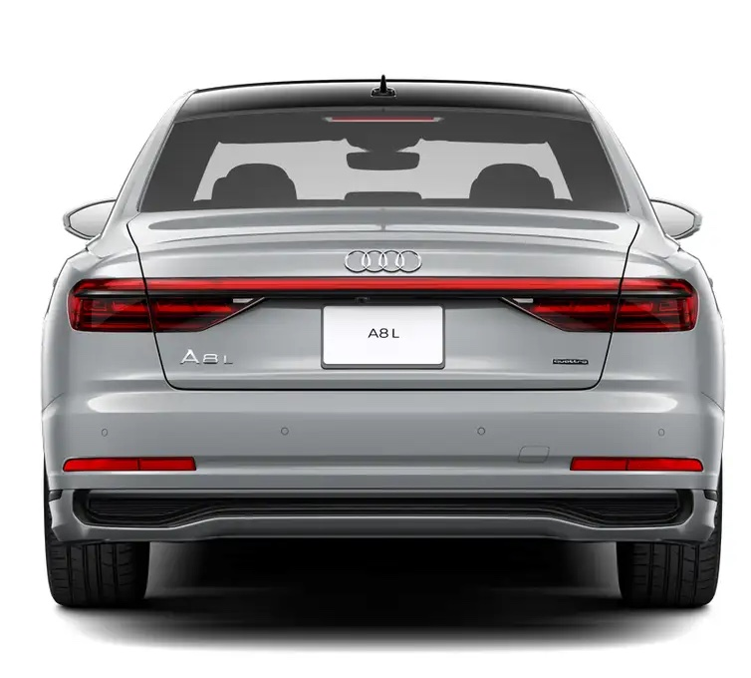
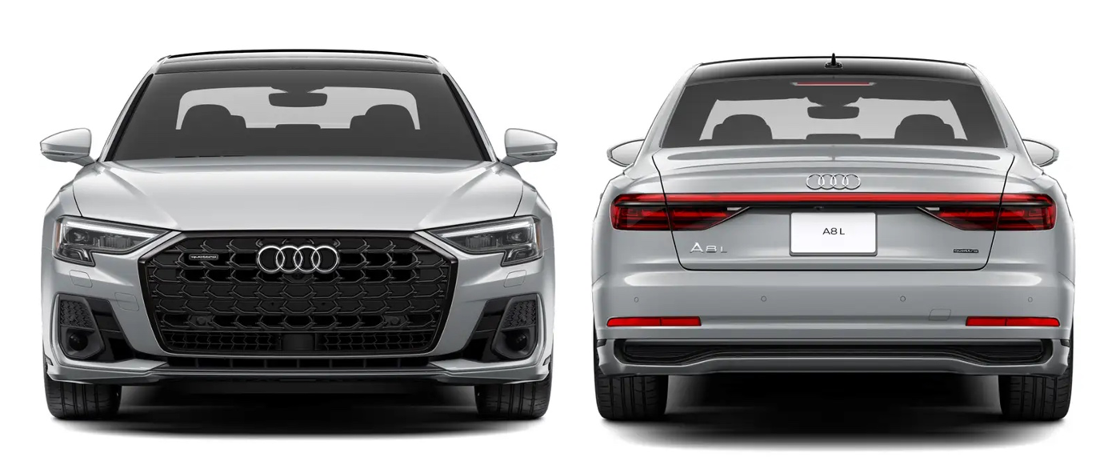
Methodology (I) Experiment I: Compare Model Performance Trained on Different Image Angle
Input Image Angle
Front
Rear
Front + Rear
1. Project Overview
4. Conclusion & Demo
2. Data & Feature Engineering
3. Methodology & Findings

Slide 14
Findings (I) Experiment I: Compare Model Performance Trained on Different Image Angle
Test Accuracy for different CNN configuration and image angles
Image Angle | MobileNet v2 | VGG-16 | DenseNet 121 | ResNet 152 | EfficientNet B0 | Average
Front | 0.951 | 0.794 | 0.957 | 0.921 | 0.972 | 0.919
Rear | 0.734 | 0.658 | 0.870 | 0.855 | 0.937 | 0.811
Front + Rear | 0.816 | 0.682 | 0.754 | 0.670 | 0.931 | 0.771
Takeaway:
Front images generate the best result compared to Rear or Front-Rear combination across all CNN architectures consistently
1. Project Overview
4. Conclusion & Demo
2. Data & Feature Engineering
3. Methodology & Findings

Slide 15
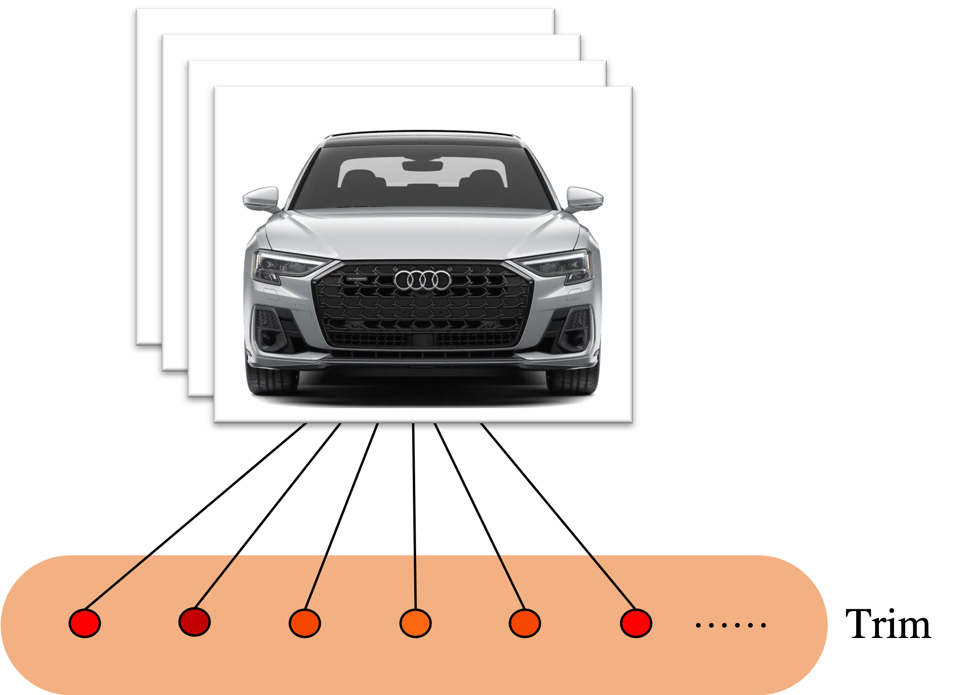
Methodology (II) Experiment II: Flat 1-Layer Model for Trim Classification
CNN Architecture
Input Image Angle
MobileNet v2
VGG-16
DenseNet 121
ResNet 152
EfficientNet B0
Front
Total 361 Classes
1. Project Overview
4. Conclusion & Demo
2. Data & Feature Engineering
3. Methodology & Findings

Slide 16
Finding (II) Experiment II: Flat 1-Layer Model for Trim Classification
Test Accuracy for different CNN configuration
 | MobileNet v2 | VGG-16 | DenseNet 121 | ResNet 152 | EfficientNet B0
Test Accuracy | 0.733 | 0.681 | 0.756 | 0.733 | 0.691
Takeaway:
DenseNet 121 outperformed other CNN architectures in classifying vehicle Trim for flat 1-layer model
1. Project Overview
4. Conclusion & Demo
2. Data & Feature Engineering
3. Methodology & Findings

Slide 17
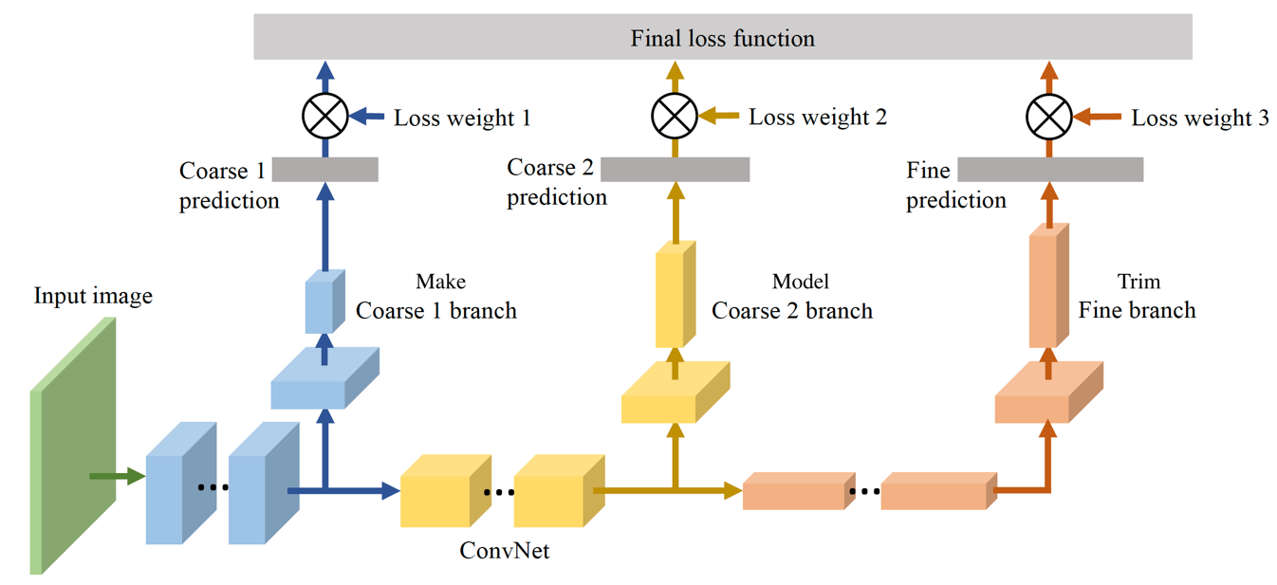
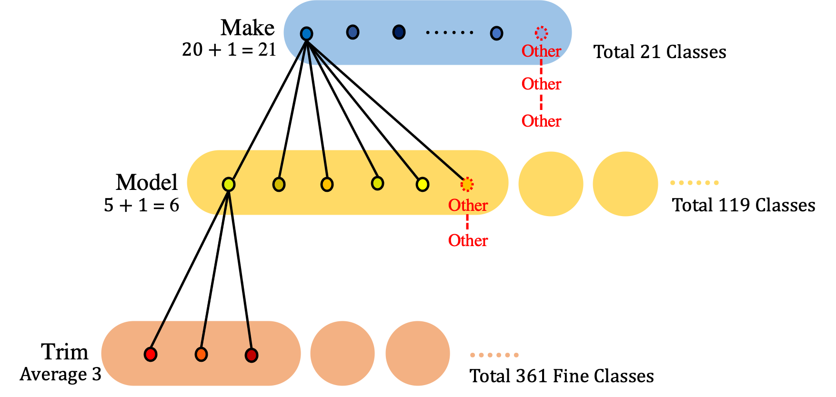
Methodology (III) Experiment III: Hierarchical 3-Layer Model for Make, Model, and Trim Classification
B-CNN consists of a main convolution workflow just like a normal CNN, with several branch networks attached to it to predict the corresponding level of categories
DenseNet 121 as main network in the B-CNN suggested by prior experiment
Branch Training Strategy with low-level weights are activated earlier than high-level weights
…
…
B-CNN Architecture
Data Structure of Hierarchical Classification
1. Project Overview
4. Conclusion & Demo
2. Data & Feature Engineering
3. Methodology & Findings
Notes:
For the hierarchical model, we used an architecture called Branch CNN or B-CNN for short. B-CNN is very similar to traditional CNN except that it has …., making it hierarchical.
From a data structure point of view, as the bottom right shows,

Slide 18
Finding (III) Experiment III: Hierarchical 3-Layer Model for Make, Model, and Trim Classification
Test Accuracy Comparison between DenseNet 121 B-CNN and Flat
Model | DenseNet 121 B-CNN | DenseNet 121 Flat
Layer 1 (Make) | 0.980 | -
Layer 2 (Make - Model) | 0.968 | -
Layer 3 (Make – Model - Trim) | 0.738 | 0.756
Takeaway:
DenseNet 121 B-CNN achieved outstanding accuracy for Make and Model
Regarding Layer 3 accuracy, flat structure is slightly better than hierarchical structure
1. Project Overview
4. Conclusion & Demo
2. Data & Feature Engineering
3. Methodology & Findings

Slide 19
Conclusion & Demo

Slide 20
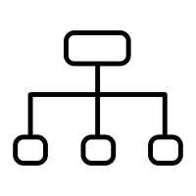
Conclusion
2. DenseNet 121 performs the best for flat structure
3. Hierarchical structure offers additional benefits
1. Front Images generate the best accuracy
Among existent CNN models, DenseNet 121 claims the title for doing one-layer classification by achieving a test accuracy of 0.756.
Although the hierarchical structure has slightly lower trim accuracy, it is still better than flat structure due to its high efficiency and interpretability.
Compared to Rear, and Front & Rear combination, Front images tend to produce the best prediction accuracy across all architectures
1. Project Overview
4. Conclusion & Demo
2. Data & Feature Engineering
3. Methodology & Findings

Slide 21
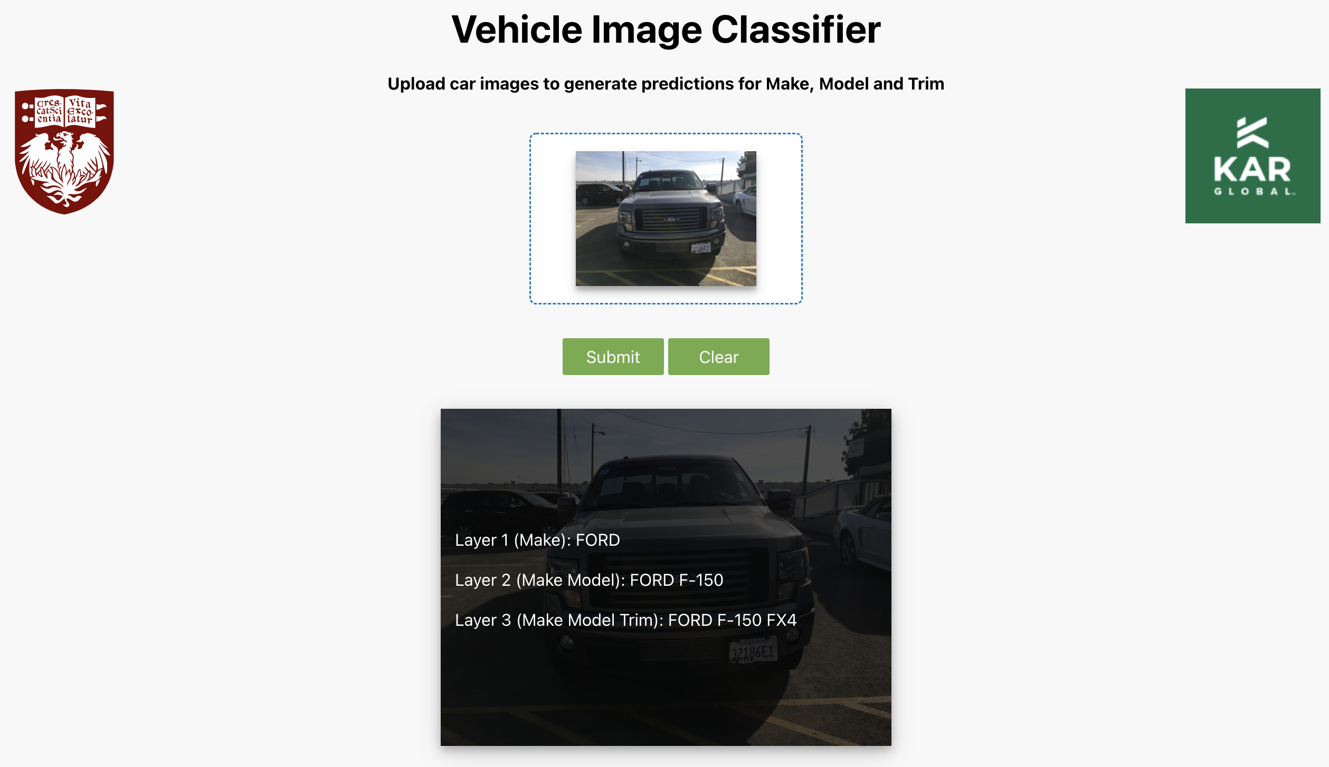
Demo
1. Project Overview
4. Conclusion & Demo
2. Data & Feature Engineering
3. Methodology & Findings

Slide 22


Acknowledgement
Bryan Binotti
Ahad Beykaei
Dr. Arnab Bose

Slide 23
Appendix

Slide 24
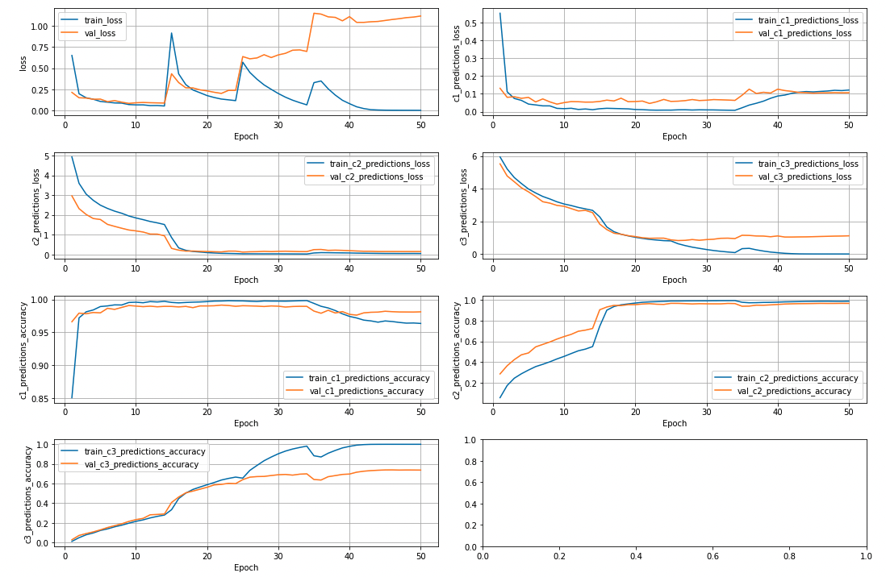
Training Process of DenseNet 121 B-CNN
Loss and Accuracy of First Layer (c1), Second Layer (c2), and Third Layer (c3) of the B-CNN Classification Model

